Slide 1

Blockchain Technology: Transforming the Digital Landscape
Blockchain technology is revolutionizing the digital landscape, offering a paradigm shift in how we store, transfer, and verify information. This groundbreaking innovation has far-reaching implications across various industries, from finance to supply chain management. As we delve into the world of blockchain, we'll explore its fundamental principles, key components, and diverse applications that are reshaping our digital interactions.

Slide 2

What is Blockchain?
1
Distributed Ledger
2
Cryptographic Security
Blockchain is a decentralized, digital ledger that records transactions across multiple computers, ensuring transparency and immutability.
It uses advanced cryptography to secure and verify transactions, making it highly resistant to tampering and fraud.
3
Consensus Mechanism
4
Chronological Chain
Transactions are grouped into blocks, which are then linked in a chronological chain, creating an unalterable history of all activities.
Blockchain relies on consensus algorithms to validate and add new transactions, eliminating the need for a central authority.

Slide 3
Decentralized, Transparent, and Secure
Decentralization
Transparency
Security
Blockchain operates on a peer-to-peer network, distributing data across multiple nodes. This eliminates single points of failure and reduces the risk of centralized control or manipulation.
All transactions on the blockchain are visible to network participants, creating an auditable trail. This transparency fosters trust and accountability among users and organizations.
Cryptographic hashing and consensus mechanisms ensure the integrity of data. Once a block is added to the chain, it becomes virtually impossible to alter, providing robust security against fraud and cyber attacks.

Slide 4
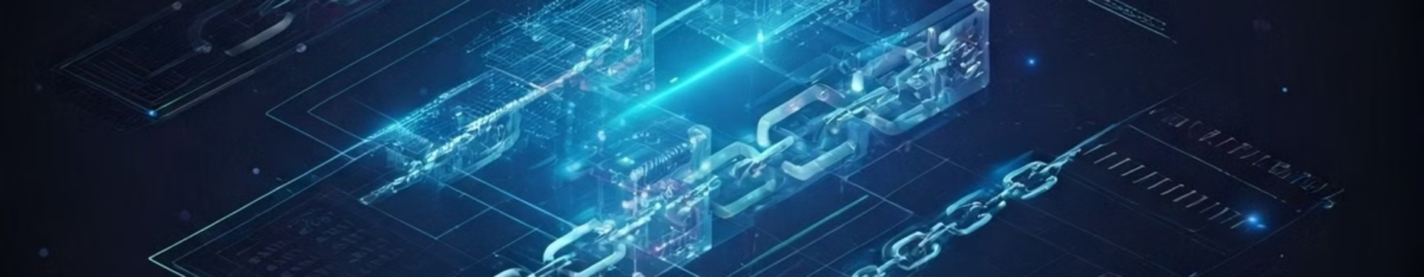




Key Components of Blockchain
Blocks
Chain
Nodes
Consensus
Containers for storing transaction data and metadata, including a timestamp and a unique identifier called a hash.
The sequential linkage of blocks, creating an immutable record of all transactions in chronological order.
Computers or devices that participate in the network, validating and relaying transactions.
Mechanisms like Proof of Work or Proof of Stake that ensure agreement on the validity of transactions and blocks.

Slide 5





Applications of Blockchain
Financial Services
Blockchain enables faster, cheaper, and more secure cross-border transactions, revolutionizing the banking and finance industry.
Healthcare
Secure sharing of medical records, drug traceability, and clinical trial management are enhanced through blockchain technology.
Supply Chain
Blockchain provides end-to-end visibility and traceability in supply chains, reducing fraud and improving efficiency.
Voting Systems
Blockchain-based voting systems can increase transparency and security in elections, potentially revolutionizing democratic processes.

Slide 6
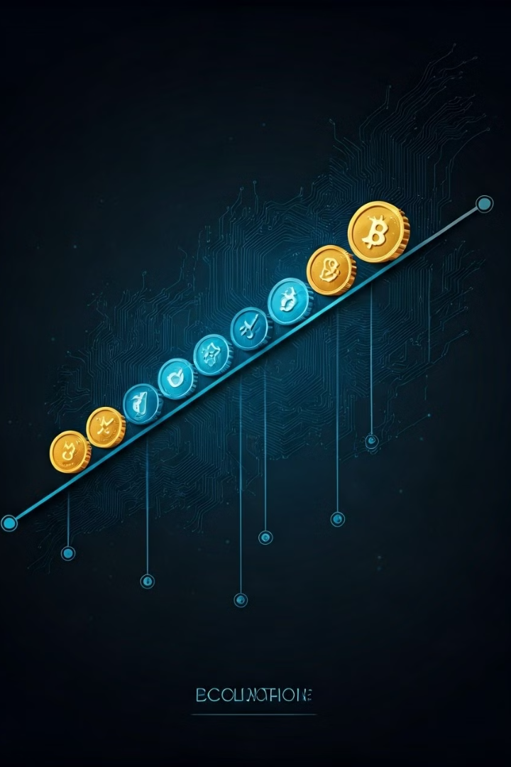
Cryptocurrencies and Digital Payments
1
Bitcoin (2009)
The first and most well-known cryptocurrency, Bitcoin introduced the concept of decentralized digital currency.
2
Altcoins (2011-present)
Alternative cryptocurrencies like Ethereum, Litecoin, and Ripple emerged, offering different features and use cases.
3
Stablecoins (2014-present)
Cryptocurrencies pegged to stable assets like fiat currencies, aiming to reduce volatility in the crypto market.
4
Central Bank Digital Currencies (CBDCs) (2020-present)
Government-backed digital currencies that leverage blockchain technology for more efficient monetary systems.

Slide 7
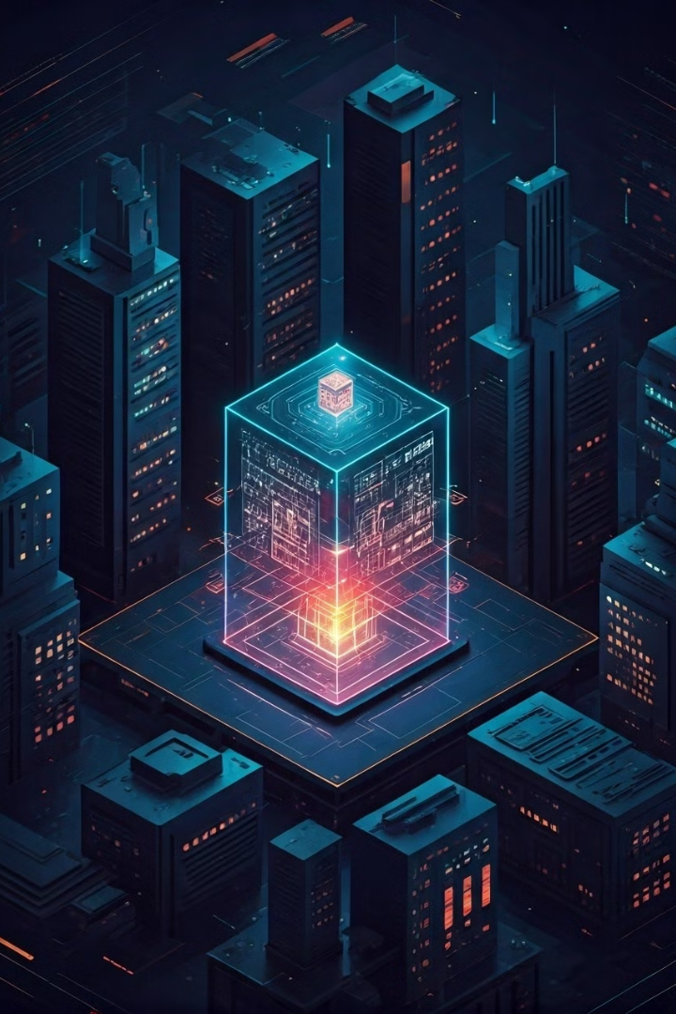
Smart Contracts and Automated Transactions
Self-Executing Agreements
Eliminating Intermediaries
By automating contract execution, smart contracts reduce the need for intermediaries, lowering costs and increasing efficiency in various industries.
Smart contracts are self-executing agreements with the terms directly written into code. They automatically enforce and execute contract terms when predetermined conditions are met.
Increased Transparency
Wide-ranging Applications
All parties can view and verify the contract terms and execution, fostering trust and reducing disputes in complex transactions.
Smart contracts can be used in various fields, including real estate, insurance, supply chain management, and decentralized finance (DeFi).

Slide 8

Supply Chain Management and Traceability
Product Origin
1
Blockchain records the source of raw materials, ensuring authenticity and ethical sourcing.
2
Manufacturing
Each step of the production process is logged, creating a transparent record of quality control and compliance.
Distribution
3
Real-time tracking of shipments enhances logistics efficiency and reduces the risk of theft or loss.
4
Retail
Consumers can verify product authenticity and history, promoting trust and brand loyalty.

Slide 9
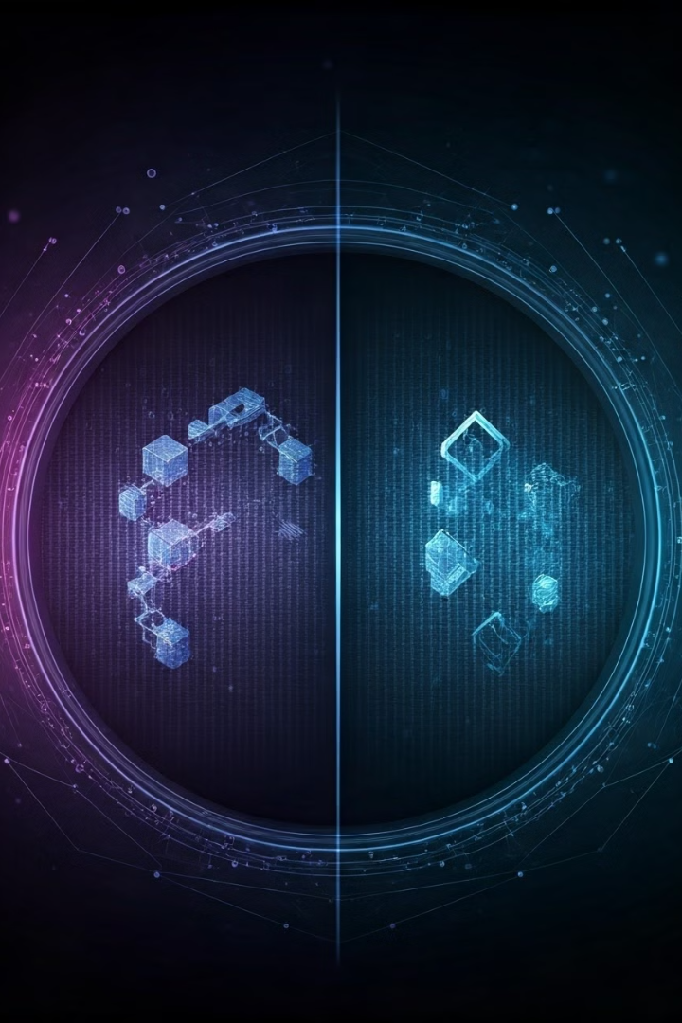
Blockchain vs. Traditional Databases
Feature
Blockchain
Traditional Database
Structure
Decentralized
Centralized
Data Modification
Immutable
Mutable
Transparency
High
Limited
Security
Cryptographic
Password-based
Consensus
Required
Not required

Slide 10



Challenges and Limitations of Blockchain
Scalability
Energy Consumption
Regulatory Uncertainty
As blockchain networks grow, they can face performance issues, limiting transaction speeds and increasing costs.
Some blockchain consensus mechanisms, like Proof of Work, require significant computational power, leading to high energy consumption.
The evolving nature of blockchain technology poses challenges for regulators, creating uncertainty in legal and compliance frameworks.

Slide 11

The Future of Blockchain Technology
Blockchain technology is transforming the world as we know it. This revolutionary technology is ushering in a new era of decentralized and secure systems, promising to disrupt traditional industries and create new opportunities. With its inherent transparency, immutability, and efficiency, blockchain is poised to revolutionize various sectors, from finance and supply chain management to healthcare and government.

Slide 12


